Slide 1
CAPSTONE PROJECT
COVID 19 ANALYSIS USING PLOTLY
PRESENTED BY
SWETHA.S
112721203012
B.TECH.CHEMICAL ENGINEERING
ST.PETER’S COLLEGE OF ENGINEERING AND TECHNOLOGY

Slide 2
PROBLEM STATEMENT
Analyze and visualize the spread and impact of covid-19 using plotly express, utilizing data sources such as daily confirmed cases, deaths, and recoveries to create interactive visualizations that provide insights into the progression of the pandemic and to develop a dashboard that can be used to track key metrics, identify trends, and communicate the severity of the pandemic to a broad audience.

Slide 3
PROPOSED SOLUTION
Utilizing plotly express, a powerful data visualization library in python, to create interactive visualizations for analyzing covid-19 data. We will start by gathering data from reliable sources such as the world health organization (WHO) or the johns hopkins university covid-19 dataset. This data will include information such as daily confirmed cases, deaths, and recoveries, as well as geographical data such as country or region.
Next, we will preprocess the data to clean and organize it for analysis. This may involve handling missing values, aggregating data by country or region, and calculating key metrics such as daily growth rates or case fatality rates.
Additionally, we will develop a dashboard using plotly dash, a web application framework for python, to display these visualizations in a user-friendly format. The dashboard will allow users to interact with the data, filter visualizations based on different criteria, and gain insights into the spread and impact of covid-19.
Overall, our proposed solution will provide a comprehensive and interactive platform for analyzing and visualizing covid-19 data, helping to improve our understanding of the pandemic and inform decision-making processes."

Slide 4
SYSTEM APPROACH(HARD WARE & SOFTWARE)
Building the proposed solution would evolve a combination of data processing, future engineering, and machine learning.
Here are the key system and library Requirements:
1. Hardware: A computer with a sufficient processing power, preferably with multiple cores or a GPU for faster training of machine learning models .Adequate RAM to handle the size of the data set and computational requirements
2. Software:- An operating system compatible with the required machine learning libraries (e.g., Windows, Linux, macOS.)

Slide 5
SYSTEM APPROACH CONT
Library requirements
For Data analysis and Manipulation
plotly.graph
plotly.io
plotly.express
pandas
For data visualization
matplotlib

Slide 6
ALGORITHM AND DEPLOYMENT
Data exploration:
Explore the Covid 19 data set structure features and target variable
Identifying potential patterns, correlations and outliers
Problem formulation
Define the problem: predict Covid 19 spread across the world
Algorithm selection
Data Preprocessing:
Imputation: Use algorithms like mean, median, or mode imputation to handle missing data in your Covid-19 dataset.
Normalization/Standardization: Depending on the algorithm you plan to use for analysis, you might need to normalize or standardize your data to ensure that all features contribute equally.
Analysis:
Statistical Analysis: You might use statistical tests like t-tests or ANOVA to compare Covid-19 metrics between different groups or countries.
Correlation Analysis: Use correlation analysis to understand the relationships between different Covid-19 metrics such as cases, deaths, and testing rates.

Slide 7
DATA INPUT
Data collection:
Gather, Country/Region, Population, Total Cases, New Cases, Total Deaths, New Deaths, Total Recovered, New Recovered, Active Cases, Serious, Critical, Tot Cases/1M pop, Deaths/1M pop, Total Tests, Tests/1M pop, WHO Region, Number of Covid-19 deaths and the reasons behind the deaths.
Data cleaning: using encoding techniques, convert categories into numerical data, and handle any inconsistencies

Slide 8
PREDICTION PROCESS
New data input : collect new data or use existing data to make predictions
Pre processing : apply the same data preprocessing steps(cleaning, feature engineering, scaling)to the new data
Model inference: use the trained model to make predictions on the new data
Results interpretation: interpret the model’s prediction, the context of the problem at hand. For regression , interpret the predicted values as optimal rates or lengths of effect.

Slide 9
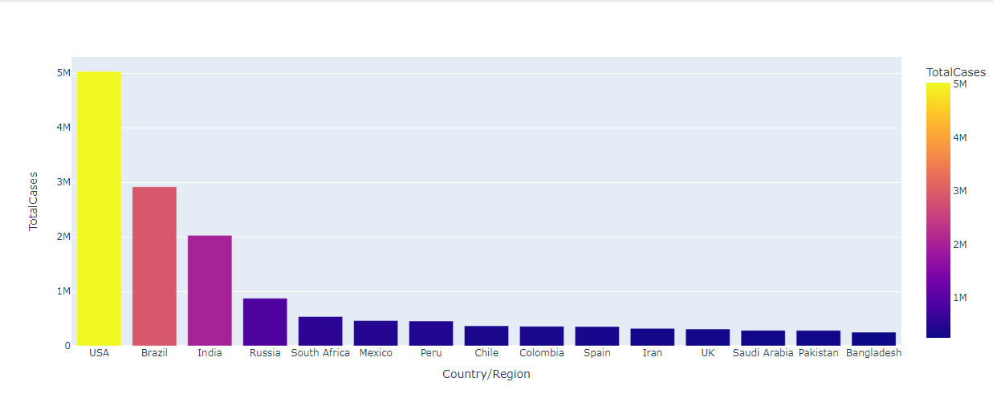
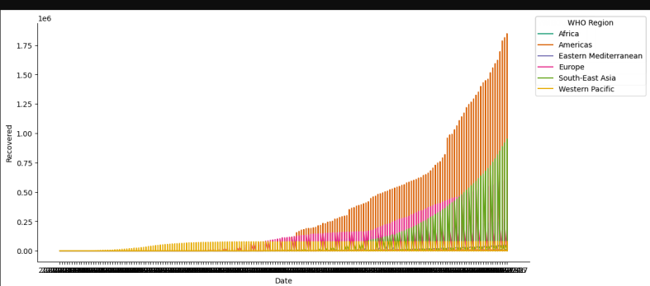
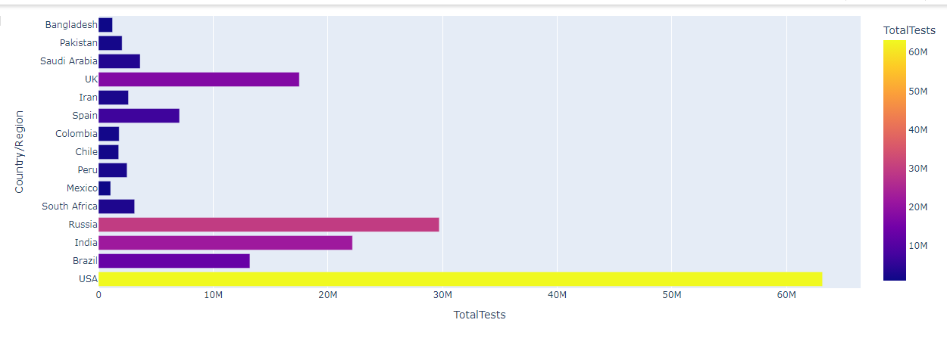
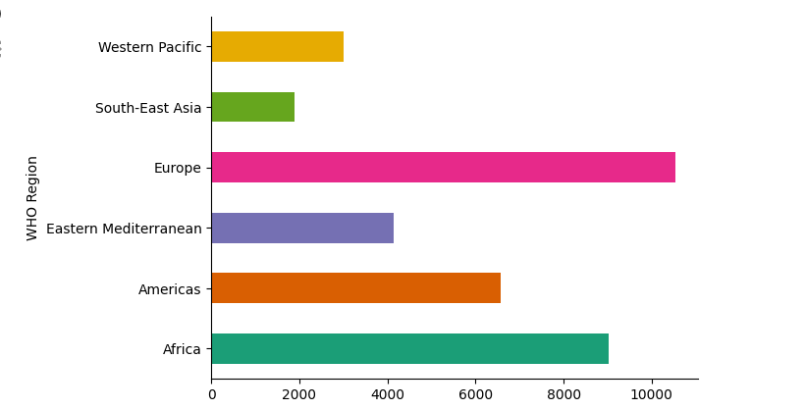
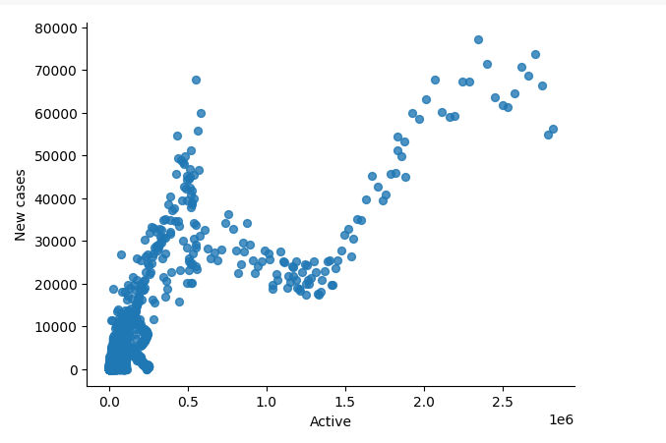
RESULT

Slide 10
CONCLUSION
This analysis summarizes the modeling, simulation, and analytics work around the COVID-19 outbreak around the world from the perspective of data science and visual analytics. It examines the impact of best practices and preventive measures in various sectors and enables outbreaks to be managed with available health resources.

Slide 11
FUTURE SCOPE
Enhanced Data Analysis: As more data becomes available, you can enhance your analysis by incorporating additional datasets. For example, you could include data on vaccination rates, healthcare capacity, or government policy responses to Covid-19.
Machine Learning for Prediction: You can expand the project to include more sophisticated machine learning models for predicting Covid-19 trends. This could involve using advanced algorithms or incorporating additional features into your models.
Real-time Updates: Implementing a system to fetch and update data in real-time would allow your visualizations to reflect the latest information on Covid-19 cases, deaths, and other metrics.
Integration with Public Health Responses: Collaborate with public health authorities to integrate your analysis into their decision-making processes, providing them with insights to inform their Covid-19 response strategies.
Education and Outreach: Use your visualizations and analysis to educate the public about Covid-19 and the importance of preventive measures, such as wearing masks and social distancing.

Slide 12
REFERENCES
https://www.kaggle.com/code/ashaabrizvi/covid-19-plotly-tutorial
https://www.kaggle.com/code/ashaabrizvi/covid-19-plotly-tutorial
https://media.geeksforgeeks.org/wp-content/cdn-uploads/20210903231151/covid.csv

